Slide 1

The Blurple Fishbirds
Documenting the creation of a full stack application with .NET Core

Slide 2
Setting up
Created a repo on Github.
Updated Gitignore
Added project with .Net to the cloned path
Created Kanban board using Trello
Loaded requirements as cards

Slide 3
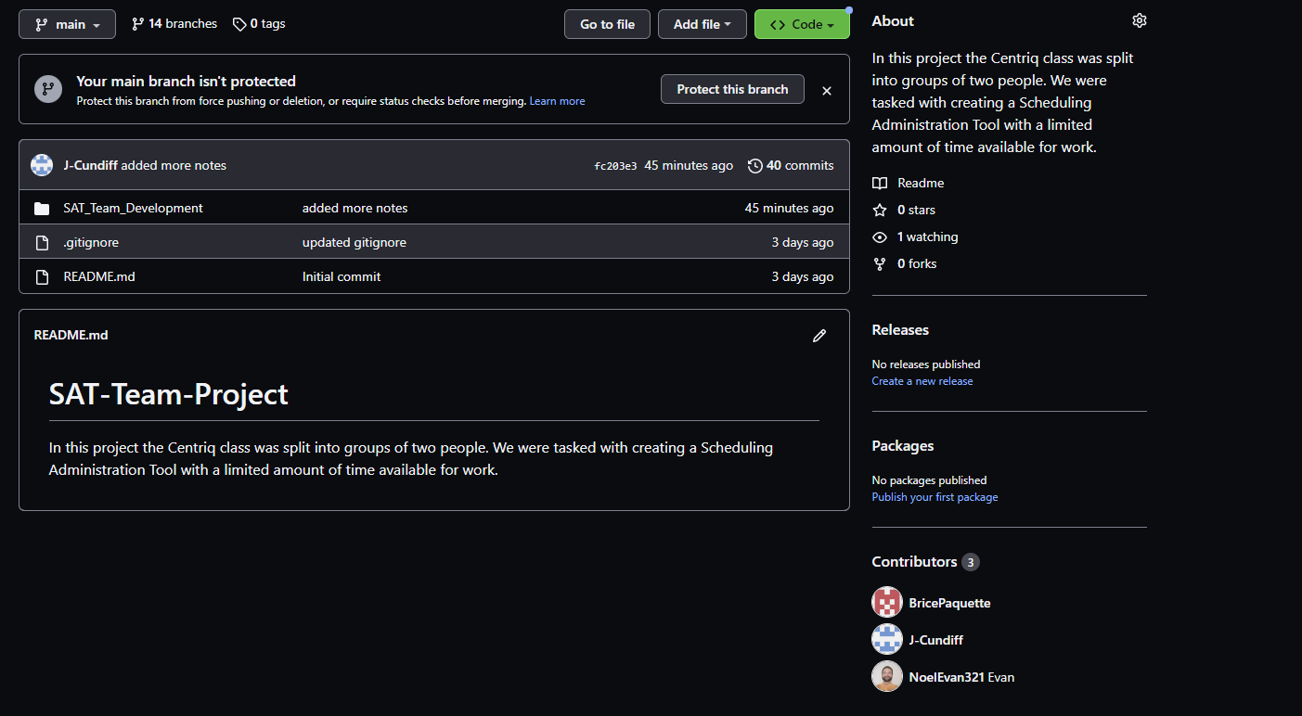

Slide 4
Dummy Data and prep
Created and scripted the database
Added records to each table per schema using SSMS.

Slide 5
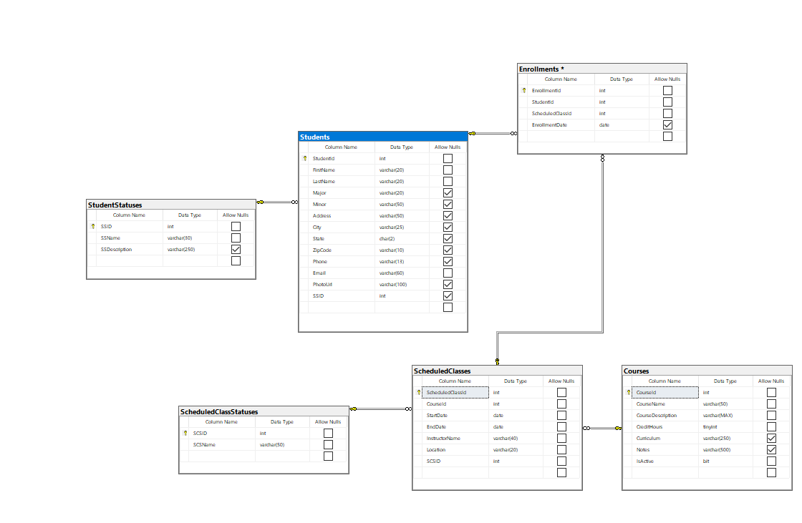
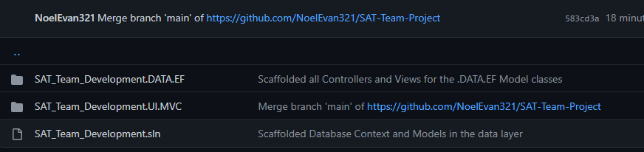

Slide 6
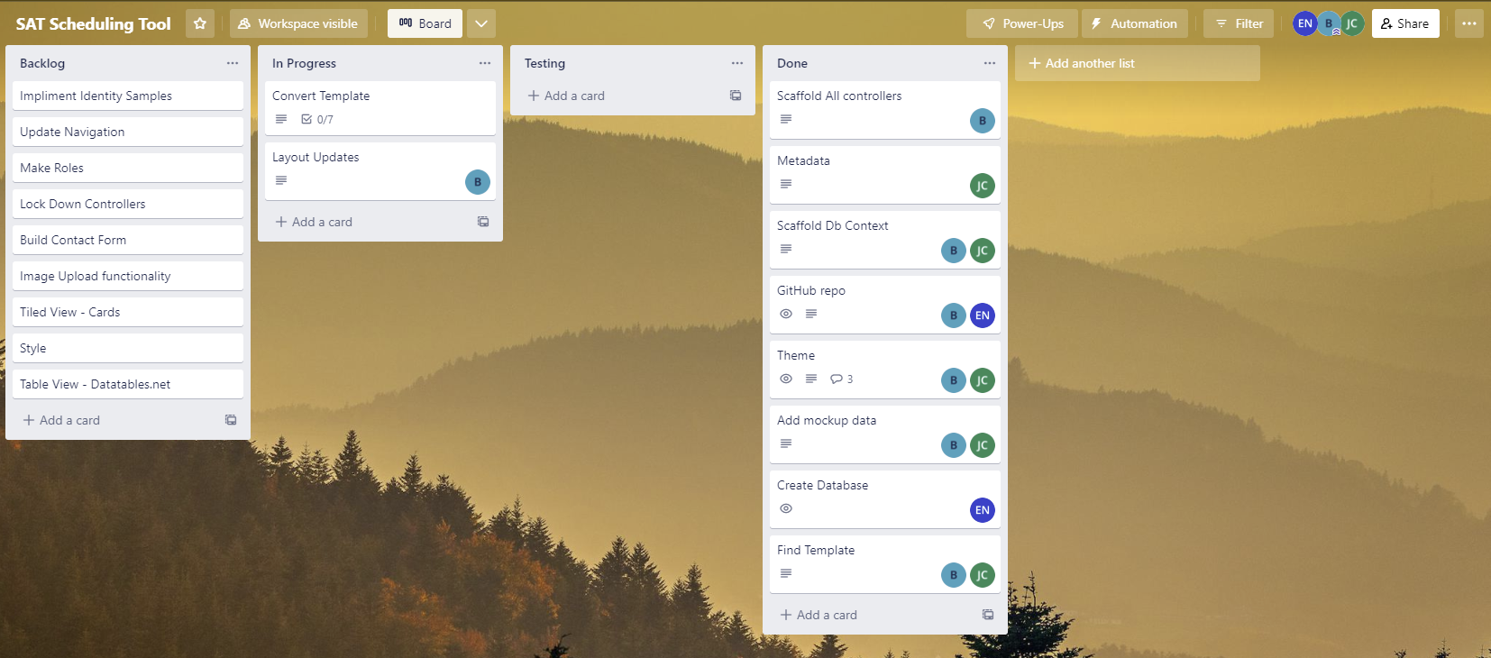

Slide 7
MVC and EF
Scaffolded DB context
Brought in data into the data layer
Created metadata and partial classes
Scaffolded all controllers and associated views

Slide 8
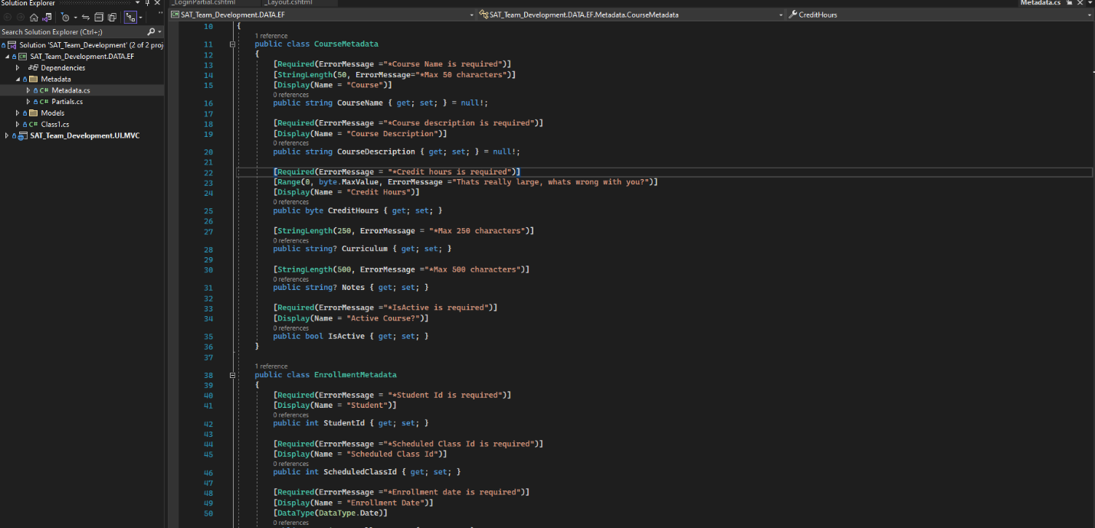
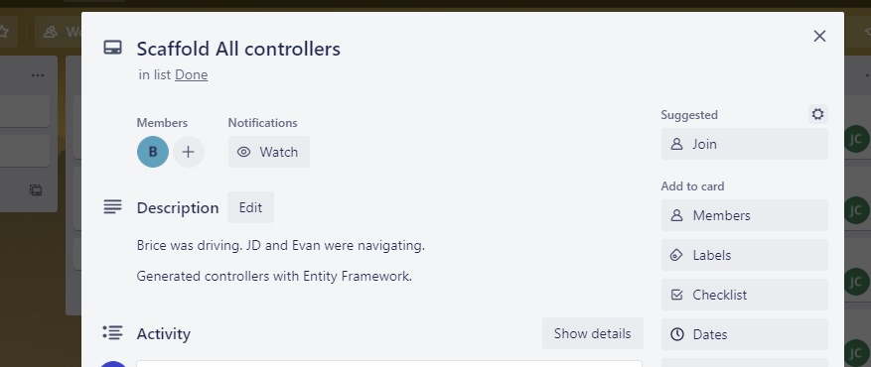

Slide 9
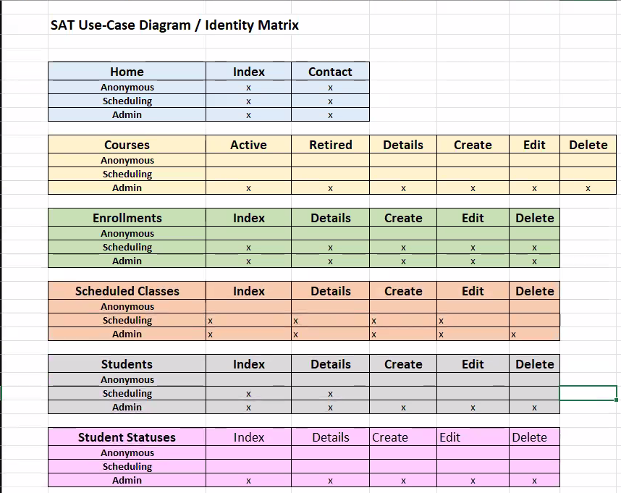

Slide 10
_Layout
Updated all links in the shared _Layout file.
Structured header and sidebar
Established ‘directory’ for the application
Cleaned vocabulary

Slide 11
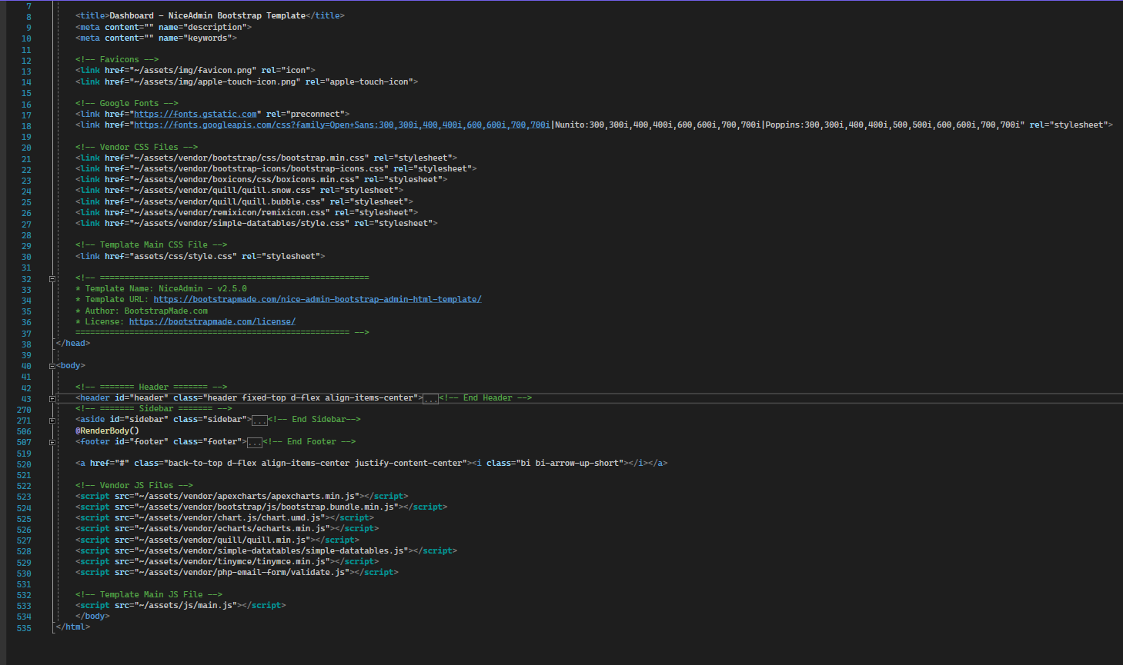
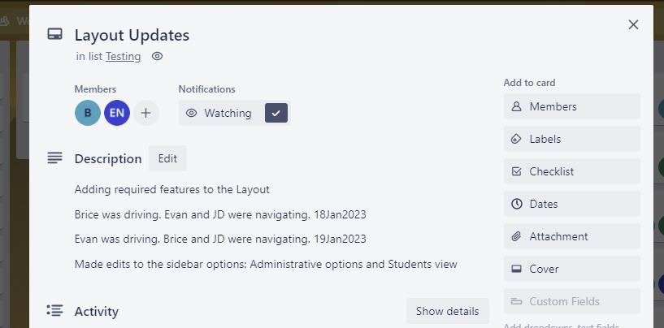

Slide 12
View Logic
Cleaned the views to be centered and use the correct terminology
Distinguished Index from other CRUD views
Implemented datatables.net
Assigned access by role per Use-Case Diagram
{insert image around here}

Slide 13
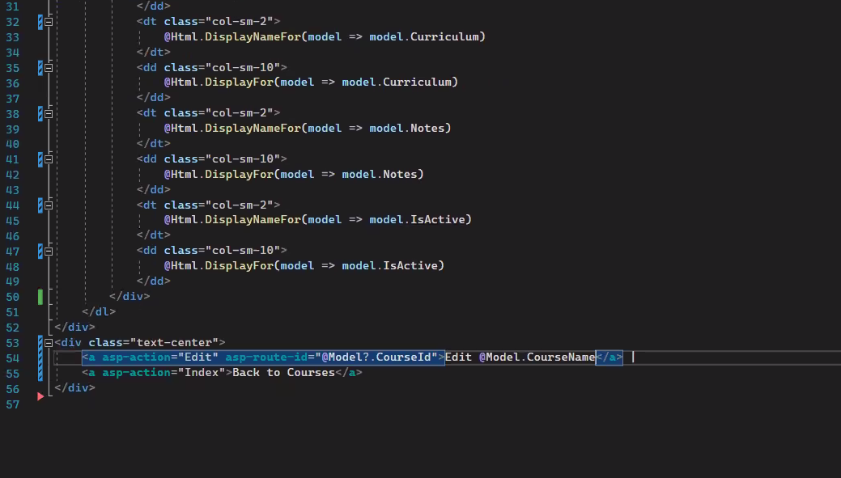
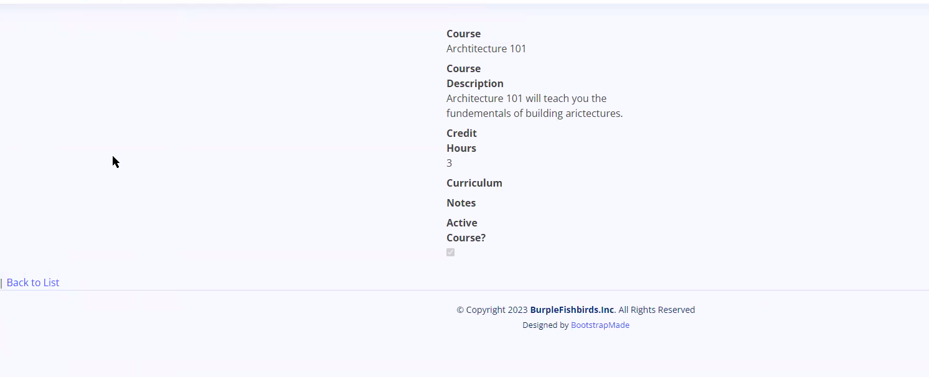
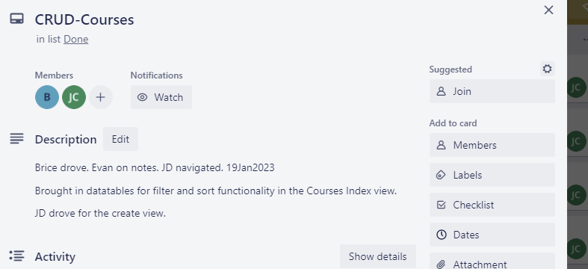

Slide 14
Contact Form
Updated the appsettings.json with functioning information
Added a Contact ViewModel for form rendering.
Brought in _config alongside _logger
Adjusted all other necessary logic for post action

Slide 15
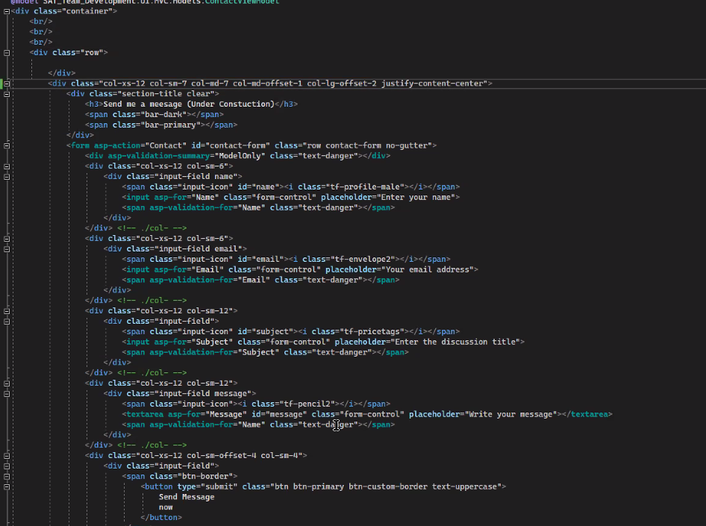
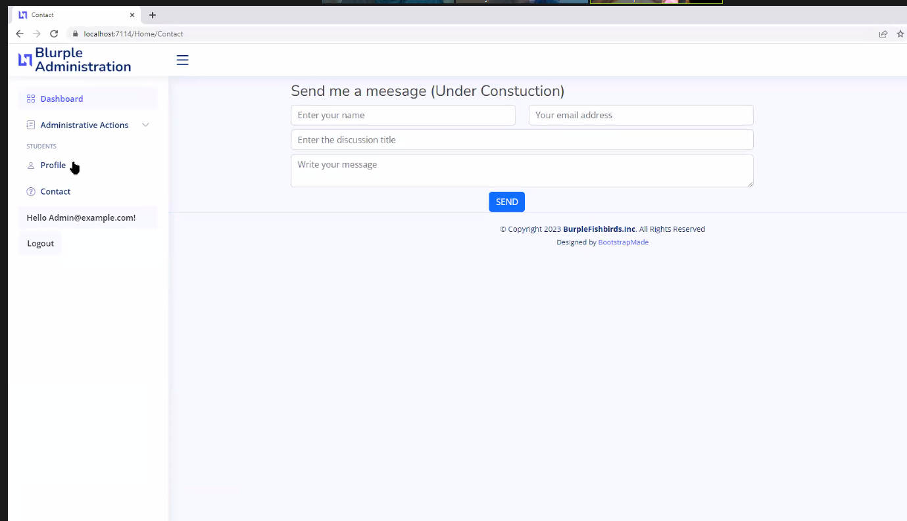
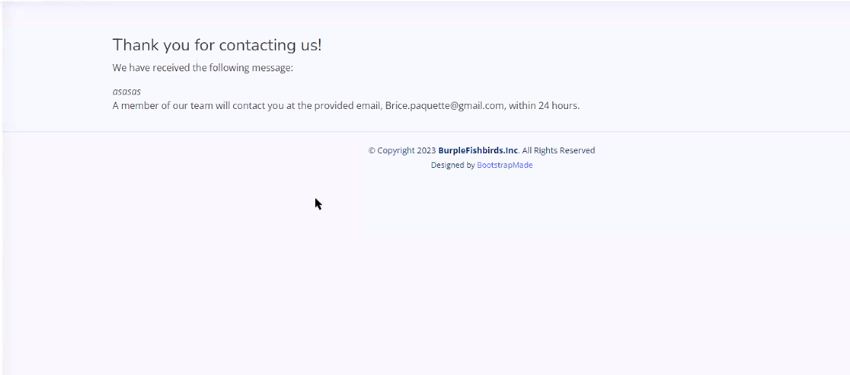

Slide 16
Testing and Wishing
Improved styling for Landing page and Layout
Conditional rendering by role
Fixed ScheduledClassId create feature to be ClassInfo partial
Reviewed the Edit submit for Enrollment and Scheduled Classes.

Slide 17
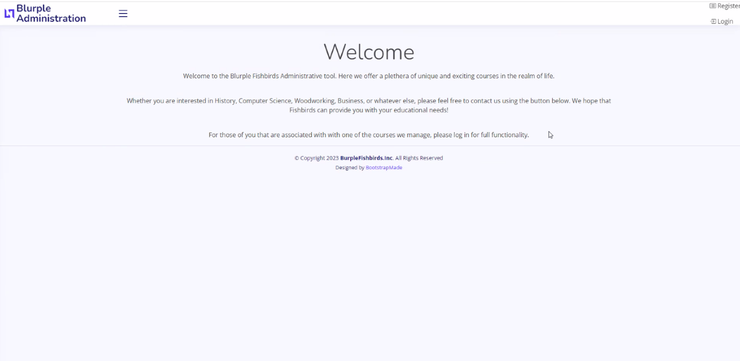
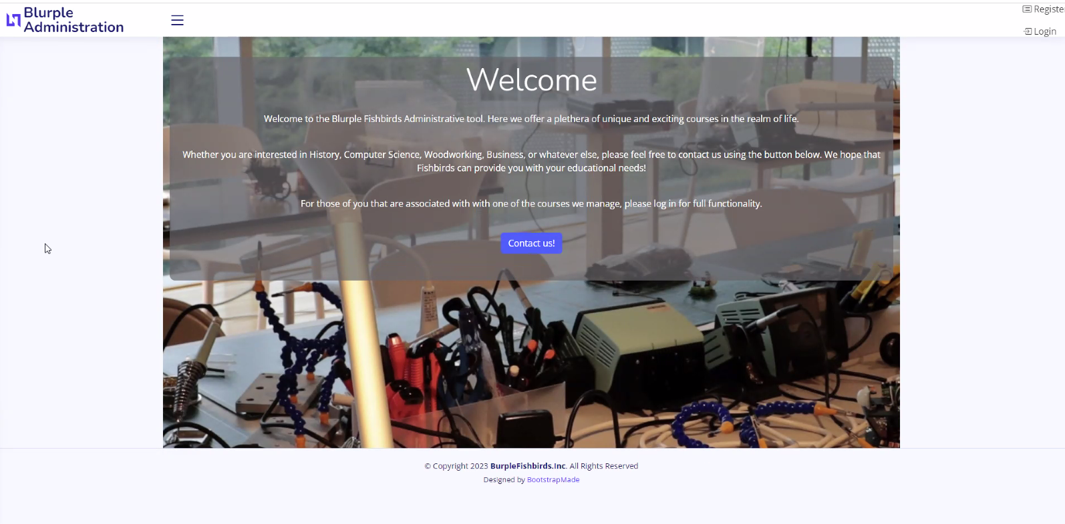

Slide 18
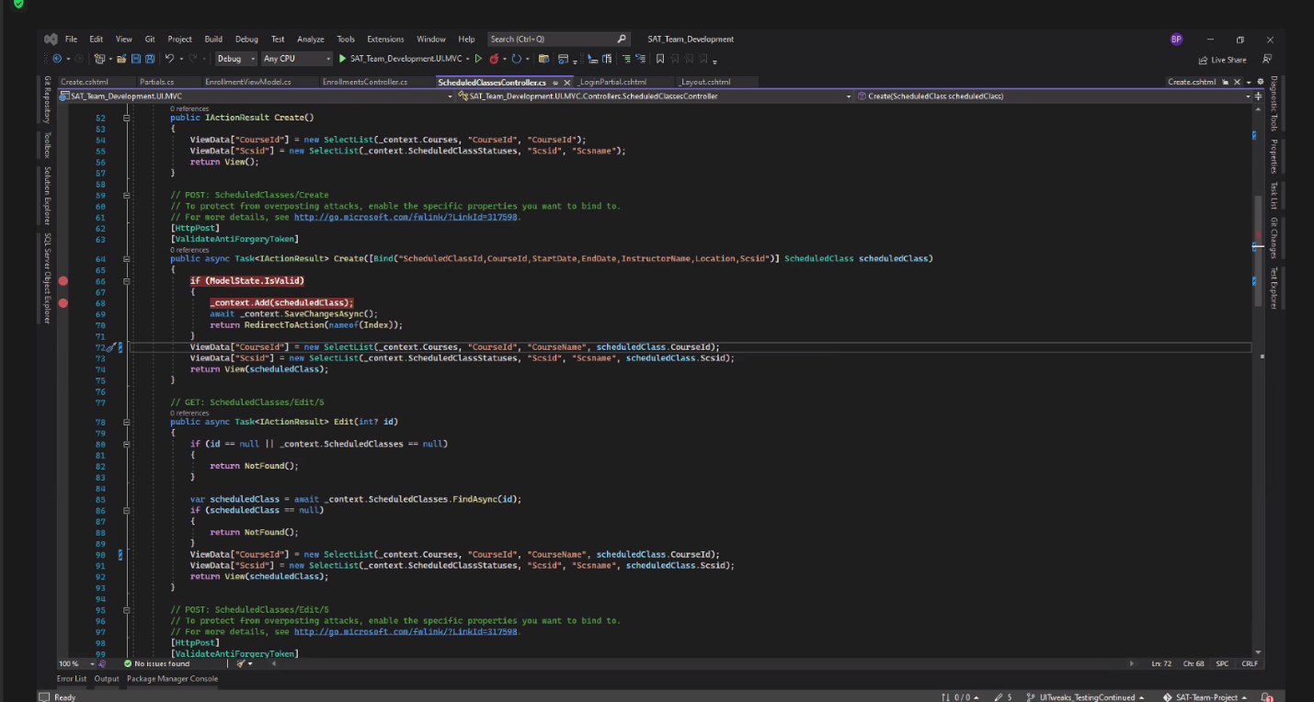

Slide 19
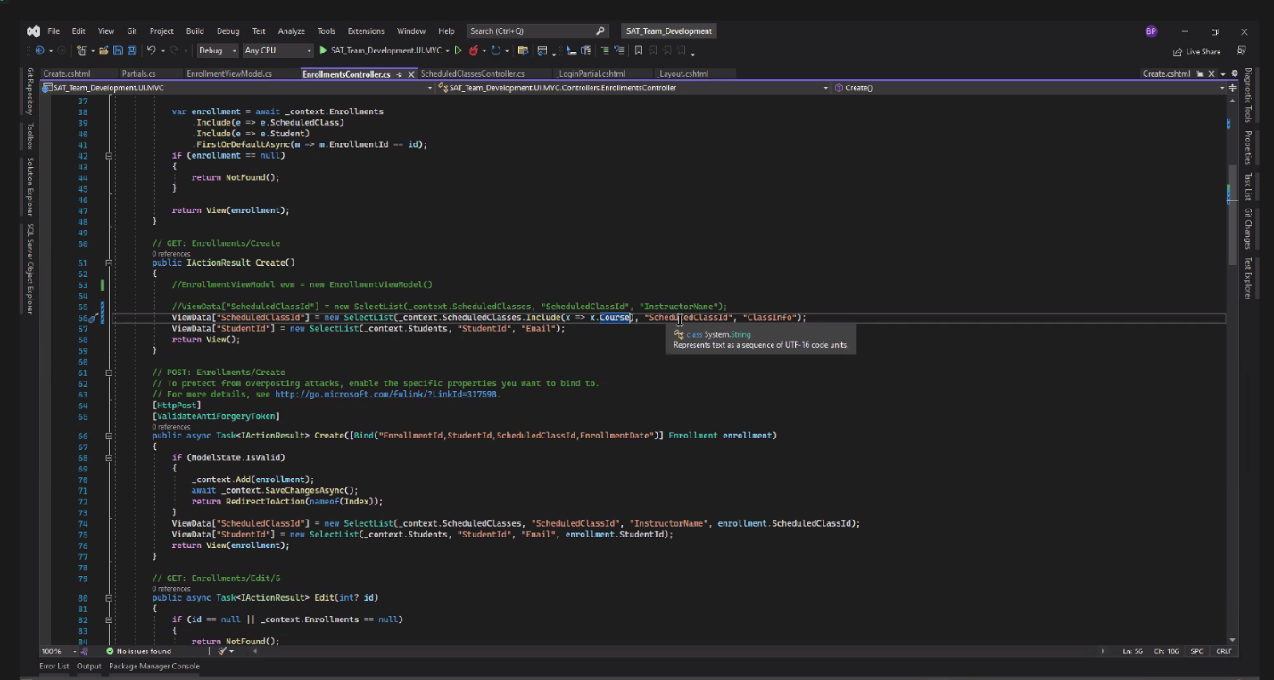

Slide 20
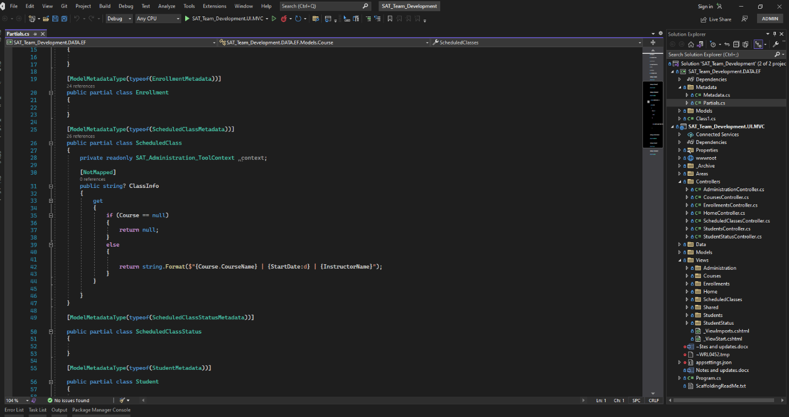

Slide 21
Documentation and Tracking
Had one person monitor the Kanban board and the ongoing notes doc.
Added ‘Docs and Tracking’ to source control
Allowed record and changing of hands between driver/navigator/assistant navigator

Slide 22
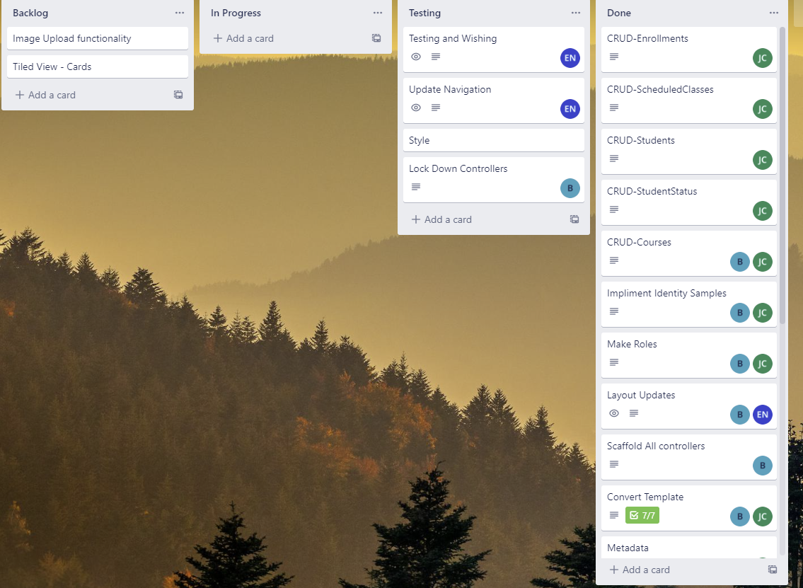
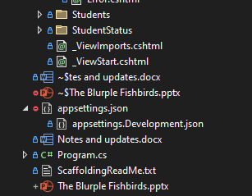

Slide 23
